Slide 1

Library Management System

Slide 2
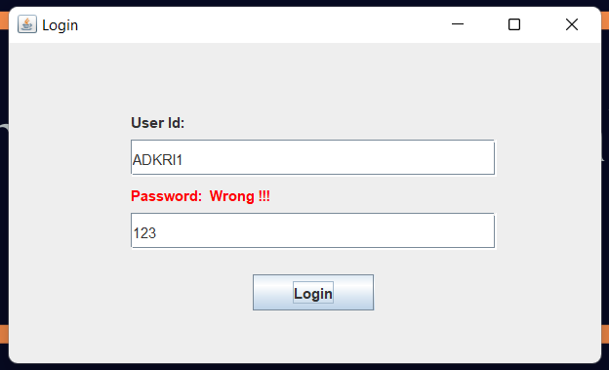
Login Window
Enter Admin credentials to open the application
Turns red if entered Password is wrong

Slide 3
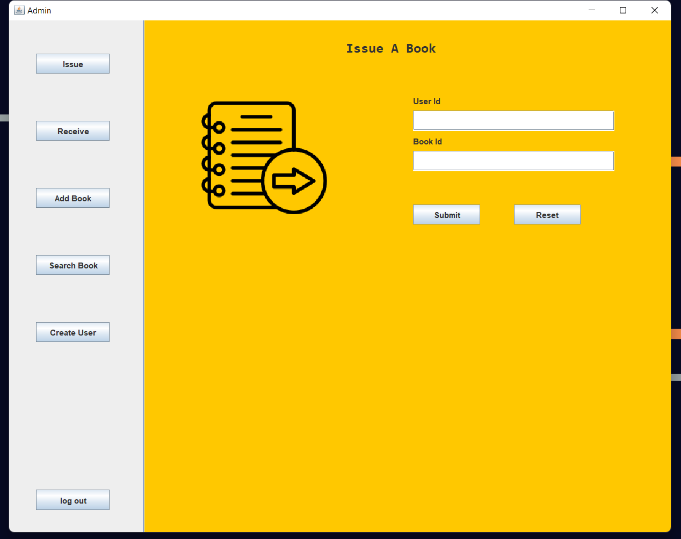
Issue Book Panel
After entering correct credentials, application starts
By default it shows panel - issue books to the user
There are 5 functionalities in this application.
Issue a book to user
Receive book from user
Add book to the library
Search a book in library
Create a user account
For issuing book User id, book id are taken as inputs and, application notes down the date of issue and due date automatically and updates in database.

Slide 4

Now, user id – VIR001 , this guy picked a book with id LON2022.
After submitting, we can see a success message saying that book is issued to the user.

Slide 5
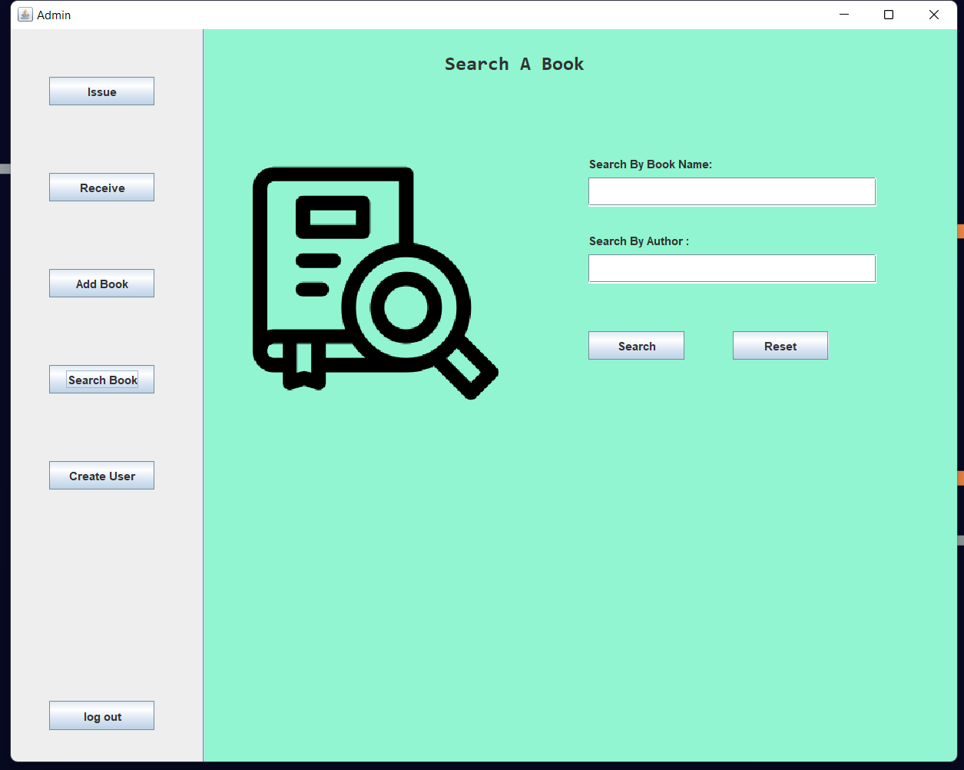
Search a book in library:
Before issuing a book to the user , admin should check whether the requested book is present in the library or all the copies have been issued to the users.
Enter book name, author name and upon clicking search button app shows how many copies are left in library.
Reset button clears the fields.

Slide 6
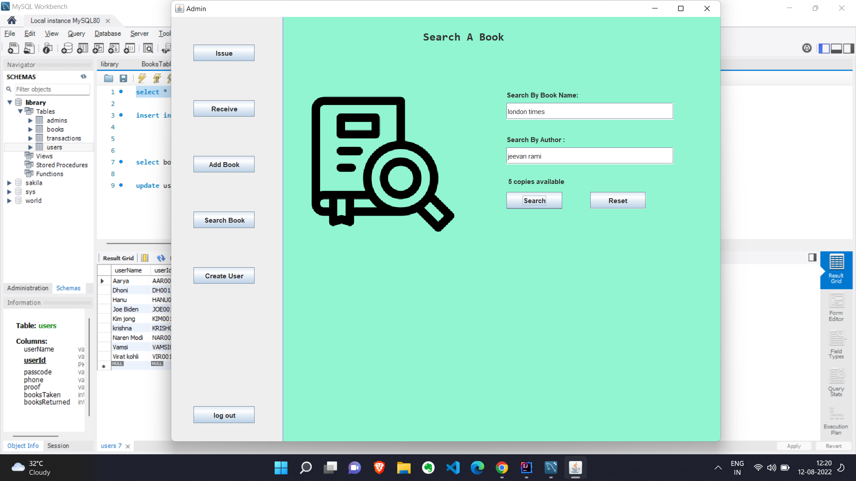
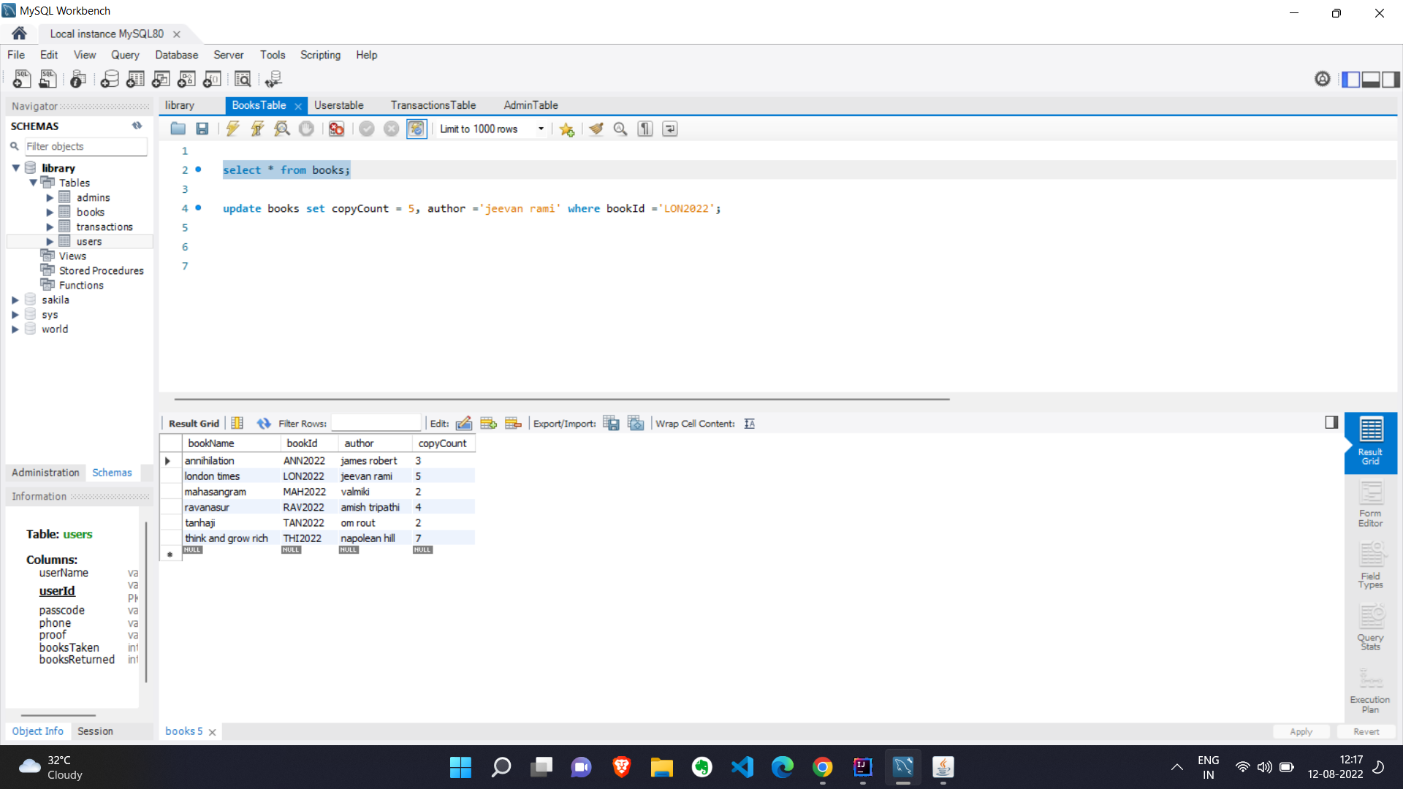
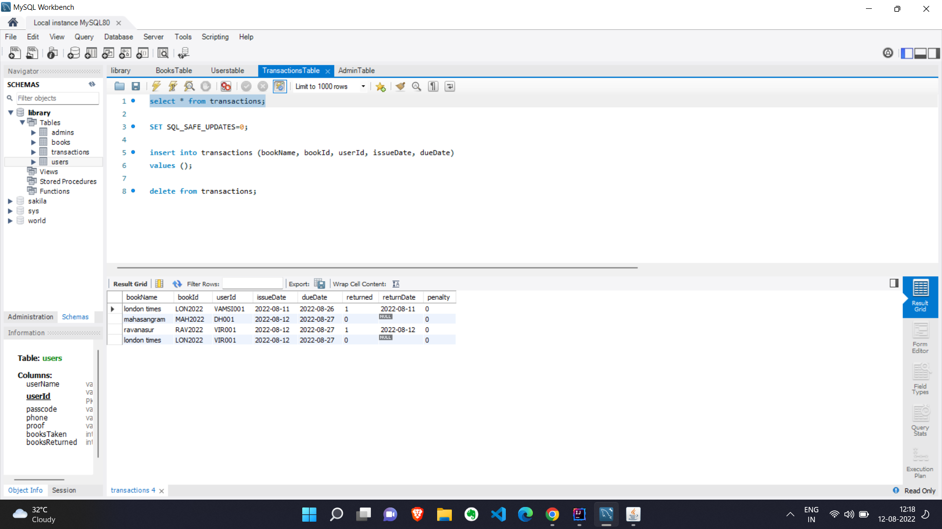
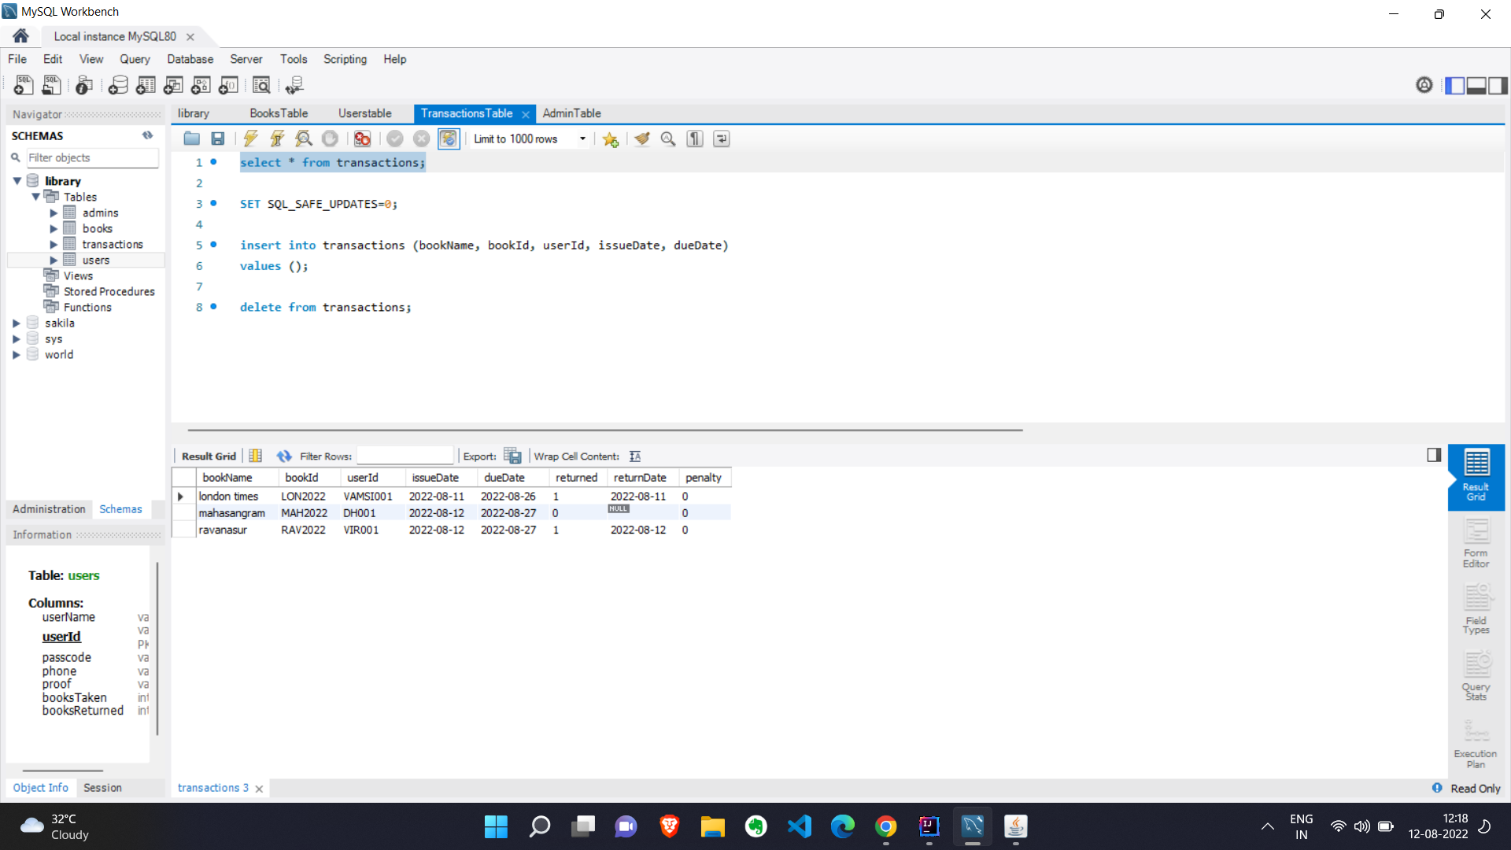
It’s having 5 copies in library before issuing book to user.
Now, we have issued a copy of London times book to user VIR001
Transaction table :After issuing book to user.
Transaction table :Before issuing book to user.

Slide 7
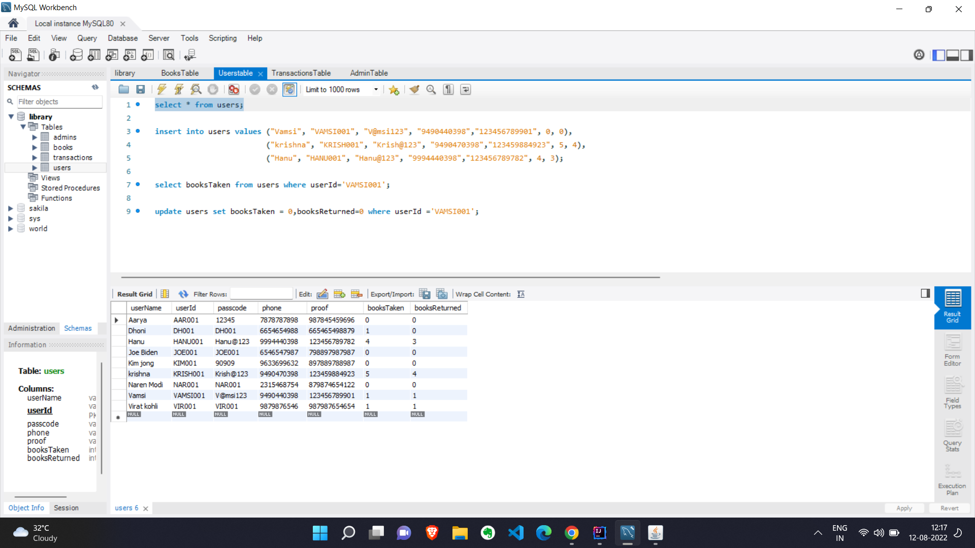

The above picture shows the number of books taken by user VIR001 (Virat Kohli). Initially it is 1.
Now after issuing it shows as 2.

Slide 8
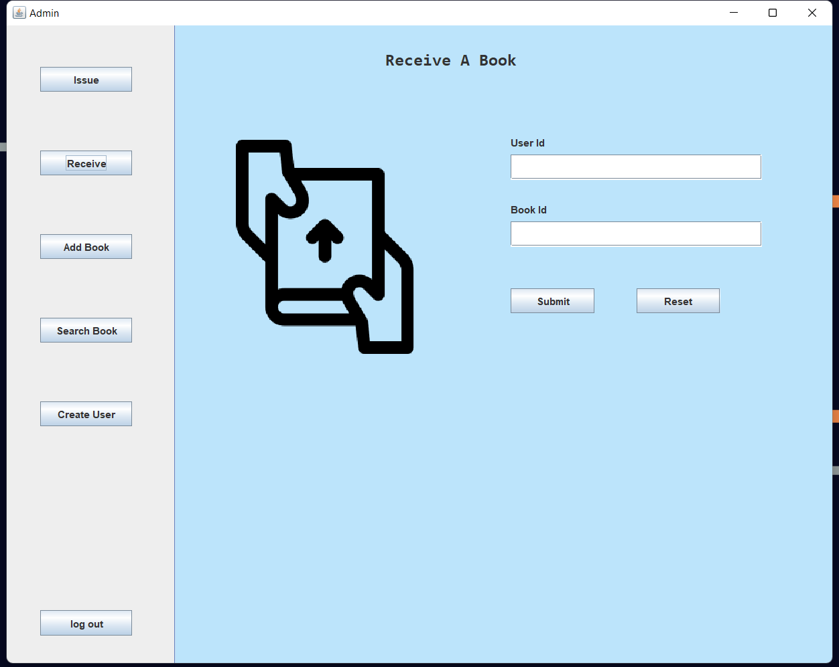
Receive Book panel
Previously, a user may have taken a book , now he is returning the book.
Takes User id number, book id num and on clicking submit. Application updates the date of return in database and calculates the penalty amount.
If the submission date is after the due date then, user should pay the penalty.

Slide 9
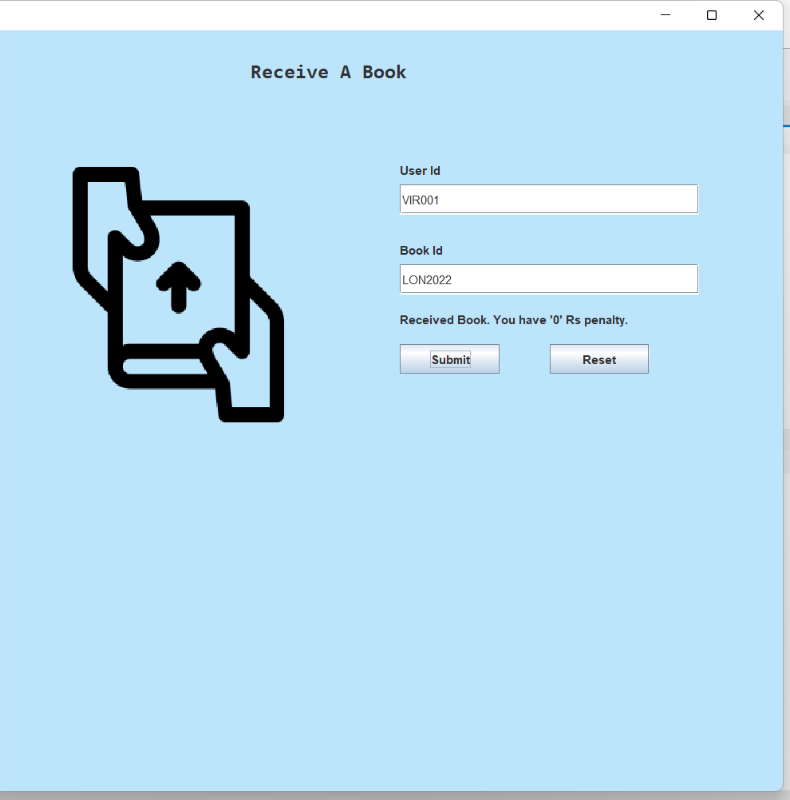
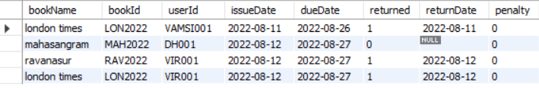
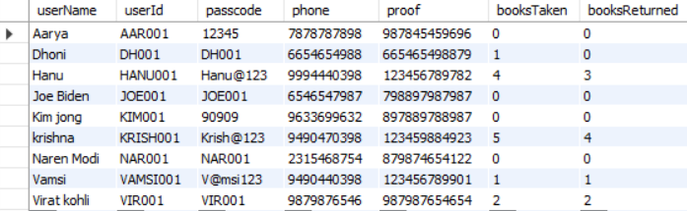
Now this, user VIR001 (Virat Kohli) returned the book on the same day.
As the submission date is before the due date there is no penalty, and we can see that in success message above submit button in the panel.
Now if you see the below table, number of books returned is 2.

Slide 10
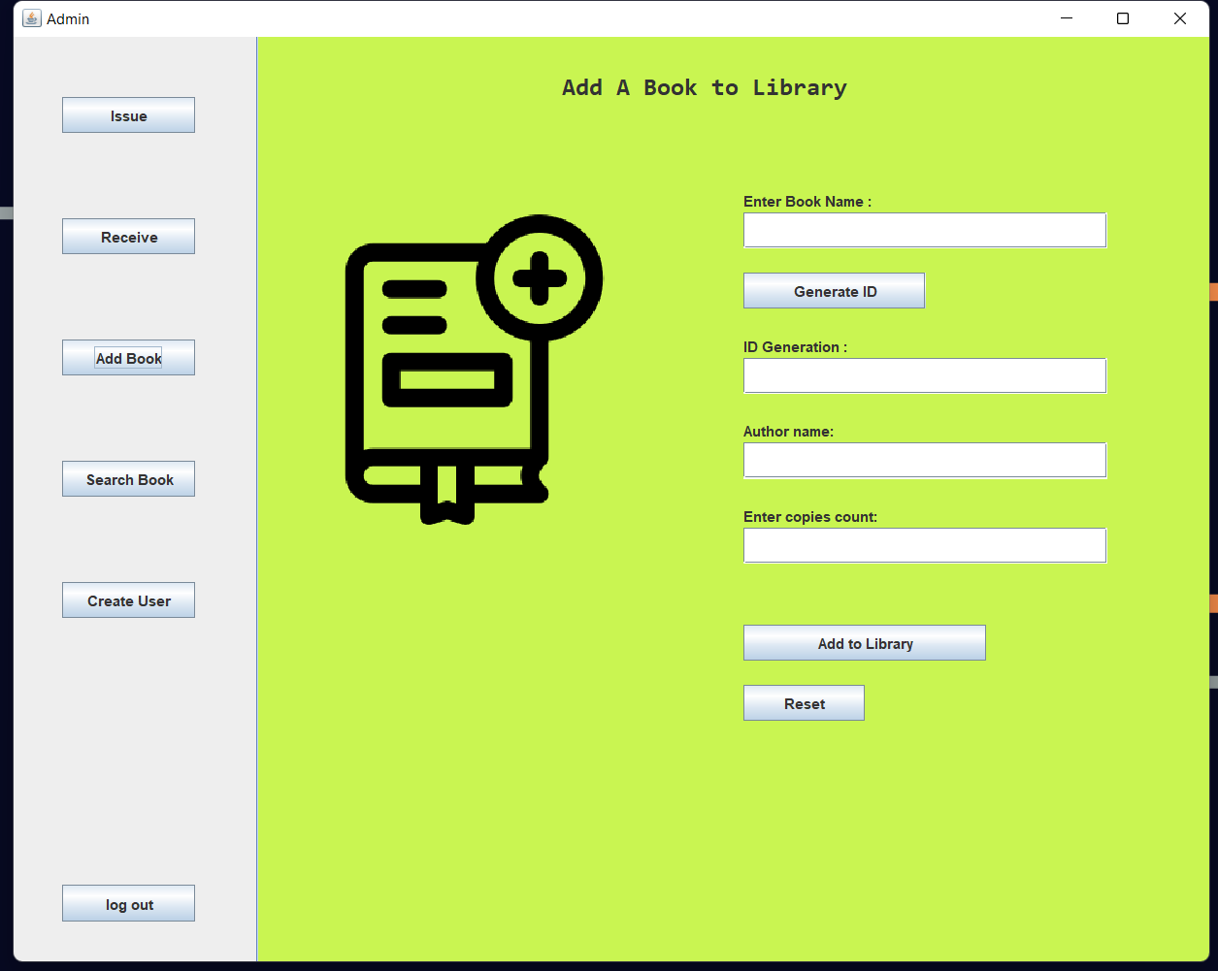
Adding book to library:
This panel is used to add books to the library.
After entering the book name, now click on generate id button. This generates a unique book id for the book.
After that provide author name and number of copies you are going to add into library.
“Add to library button” adds the books to library.
Reset button resets the fields and labels.

Slide 11
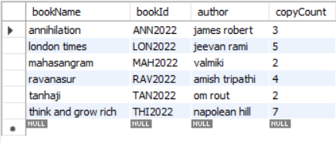
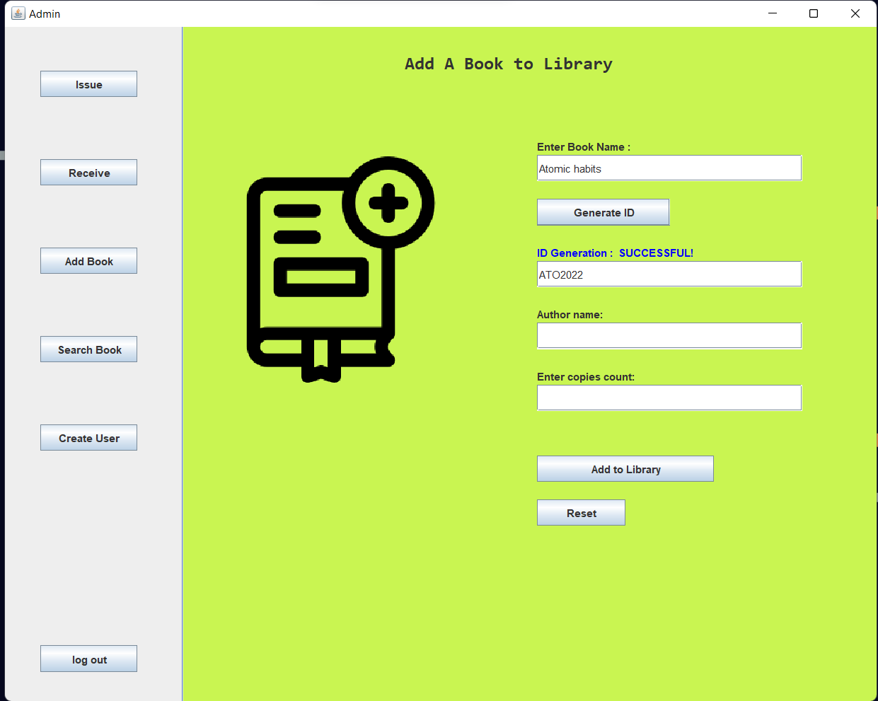
List of books present In library
After clicking on “Generate Id ” button. Success message will appear above the field.

Slide 12
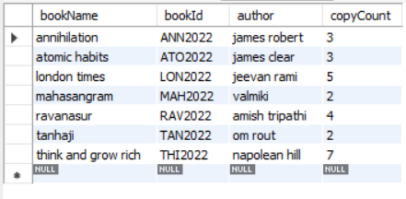
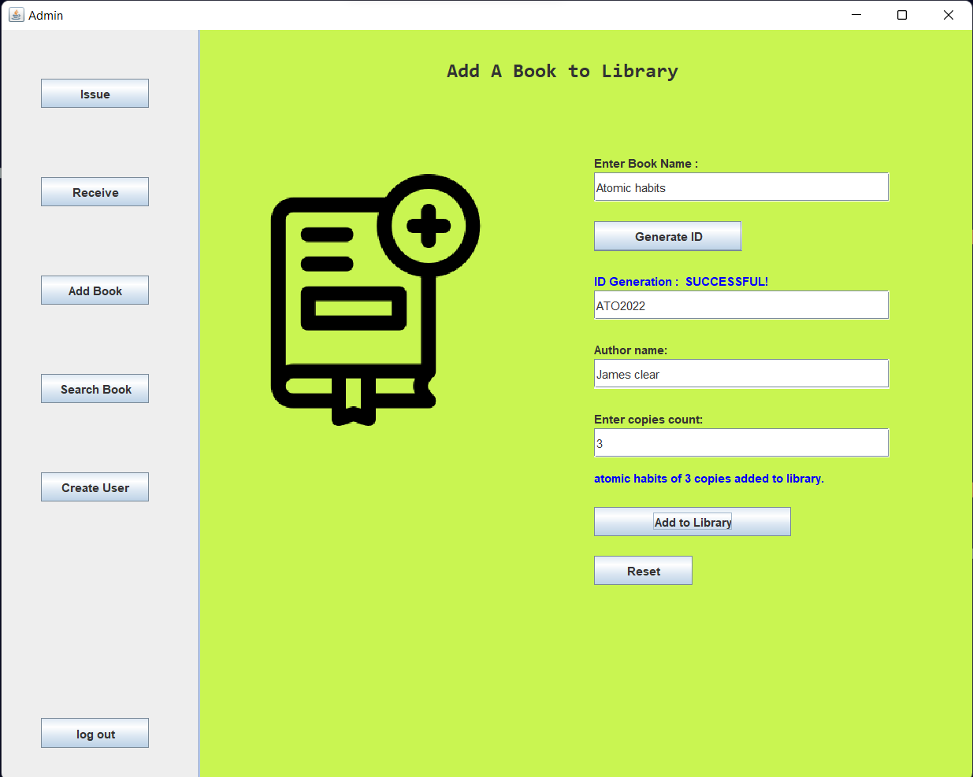
The book “Atomic habits” has been added to the library database.

Slide 13
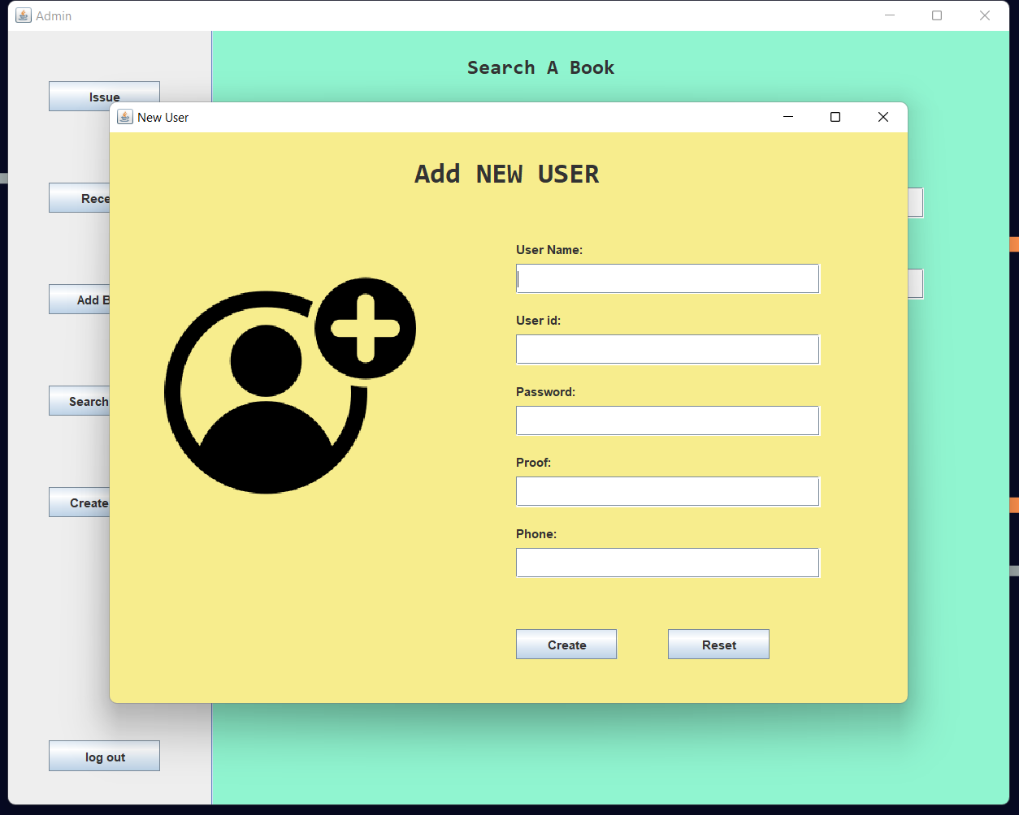
Create user account:
If the user if first time customer of the library, then he needs an account to track his records. So, admin should be able to create users
User name, user id, password, proof of id, phone number are all the details should be given and upon submitting user is added into database.

Slide 14
Thank you

